Slide 1
10/20/22

Slide 2

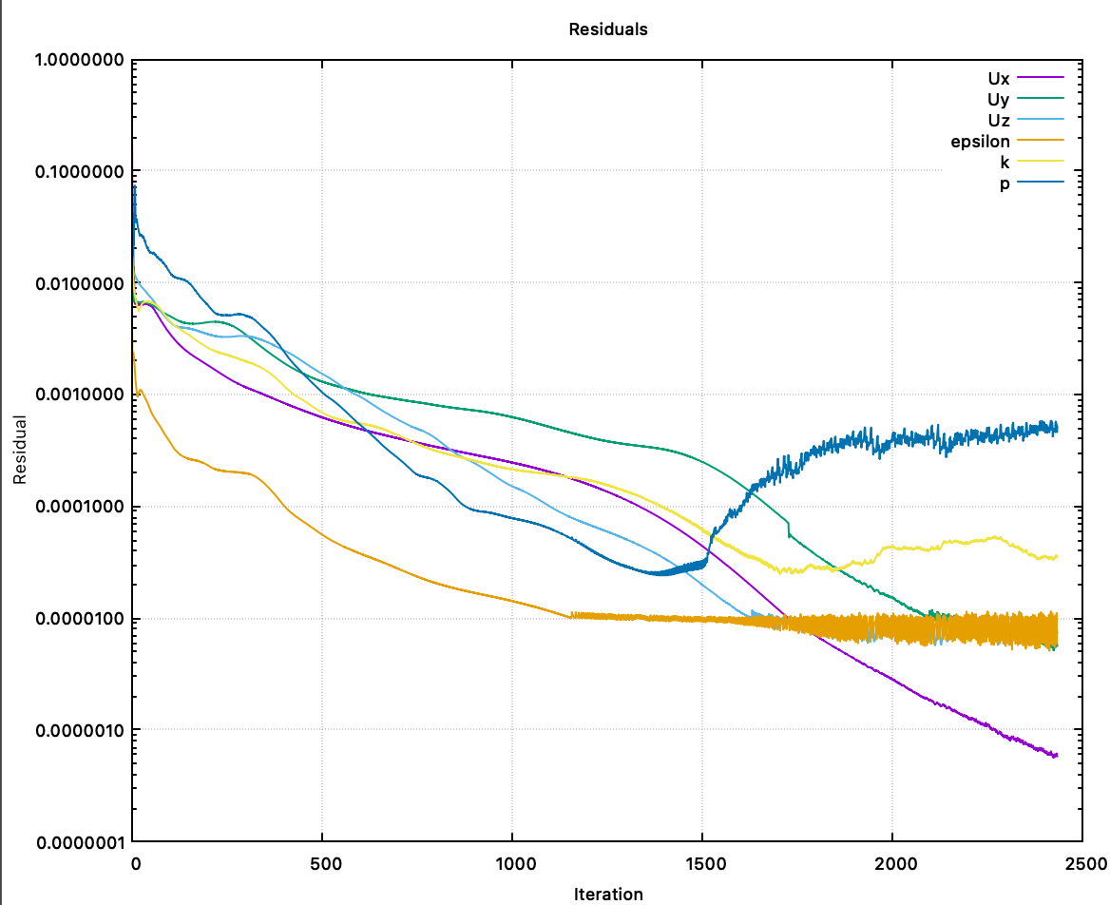
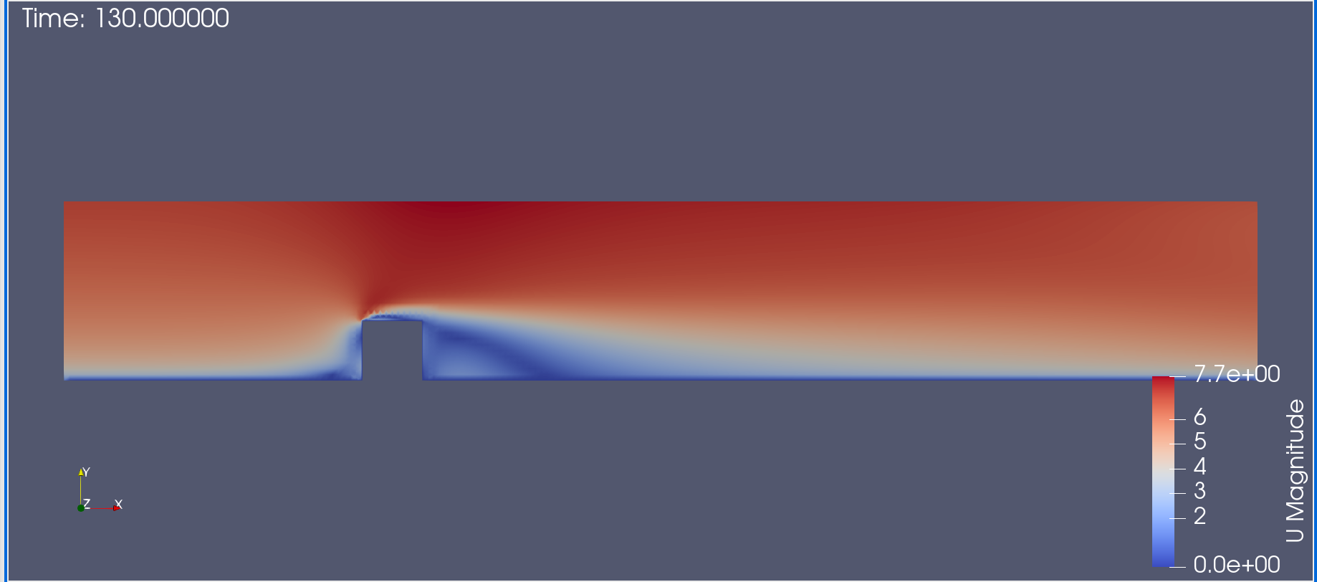
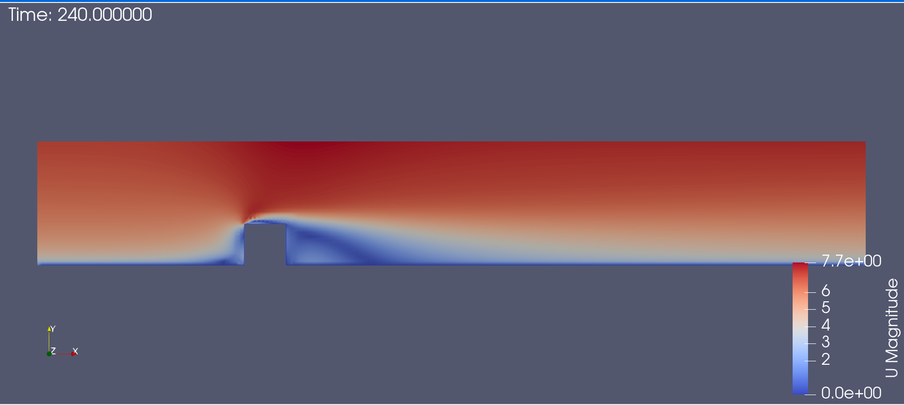
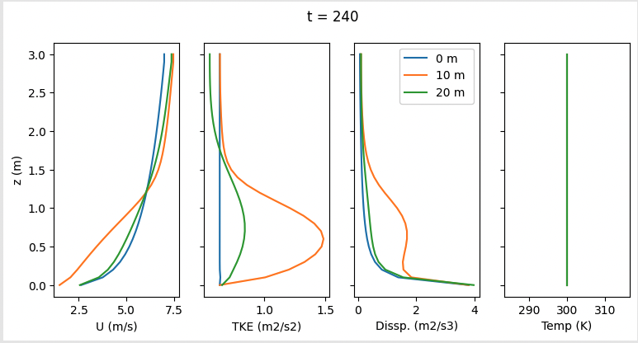
hr11C_ (shelter buoyancy slip condition with box)
* t = Iteration /10,
Residuals up to t = 240

Slide 3
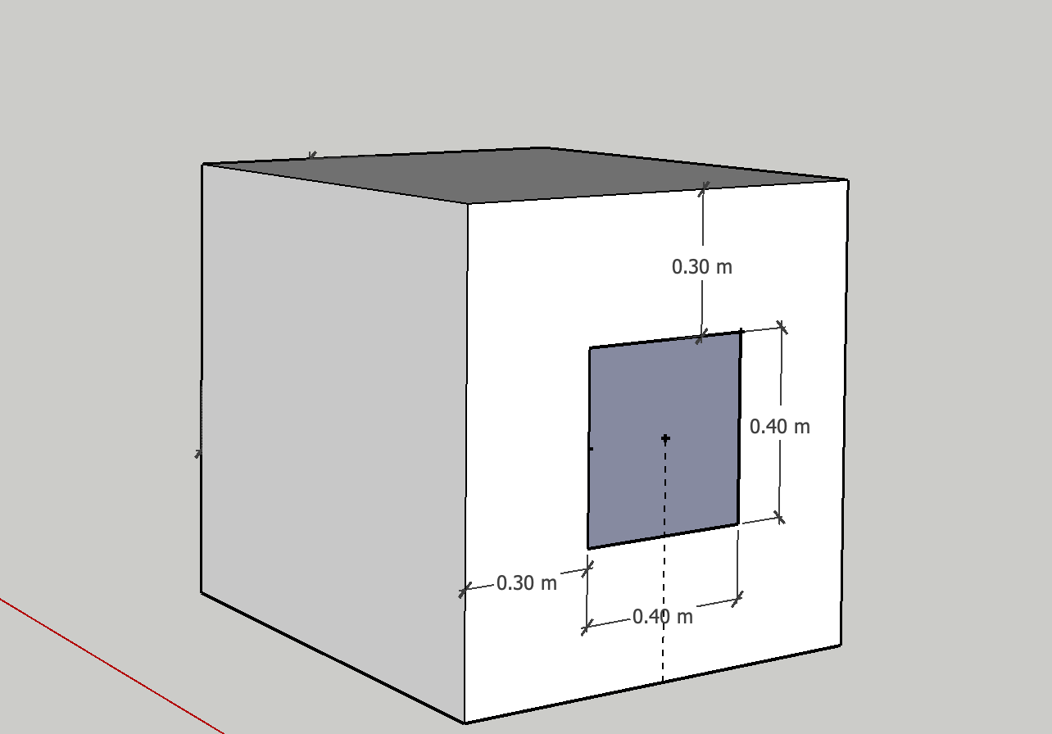
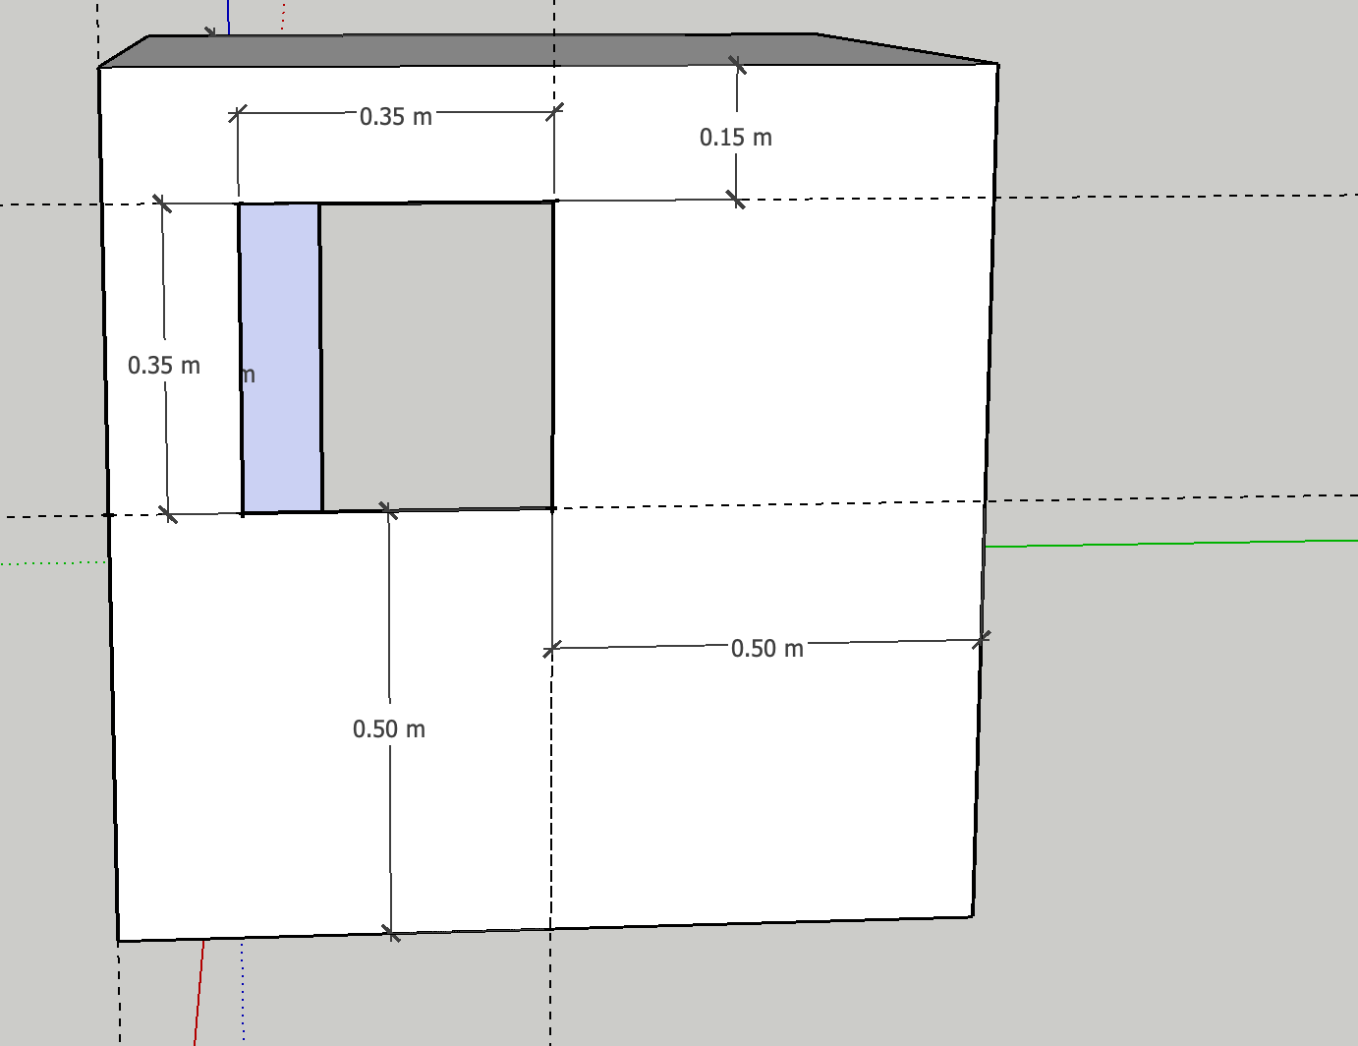
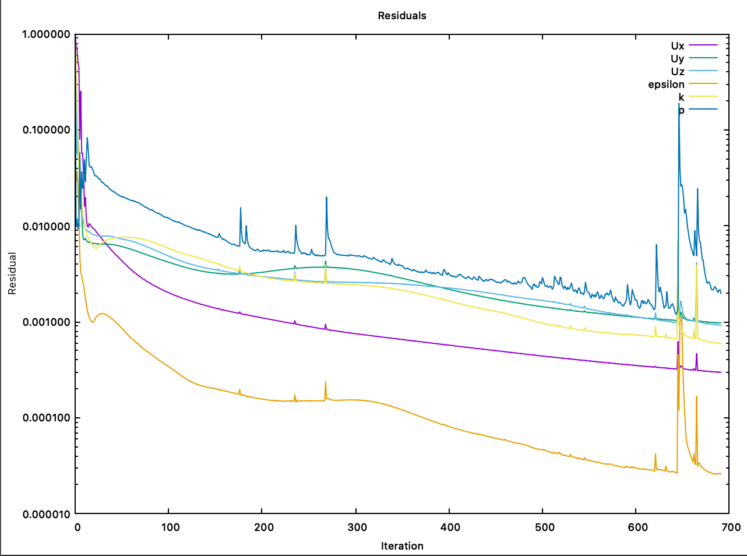
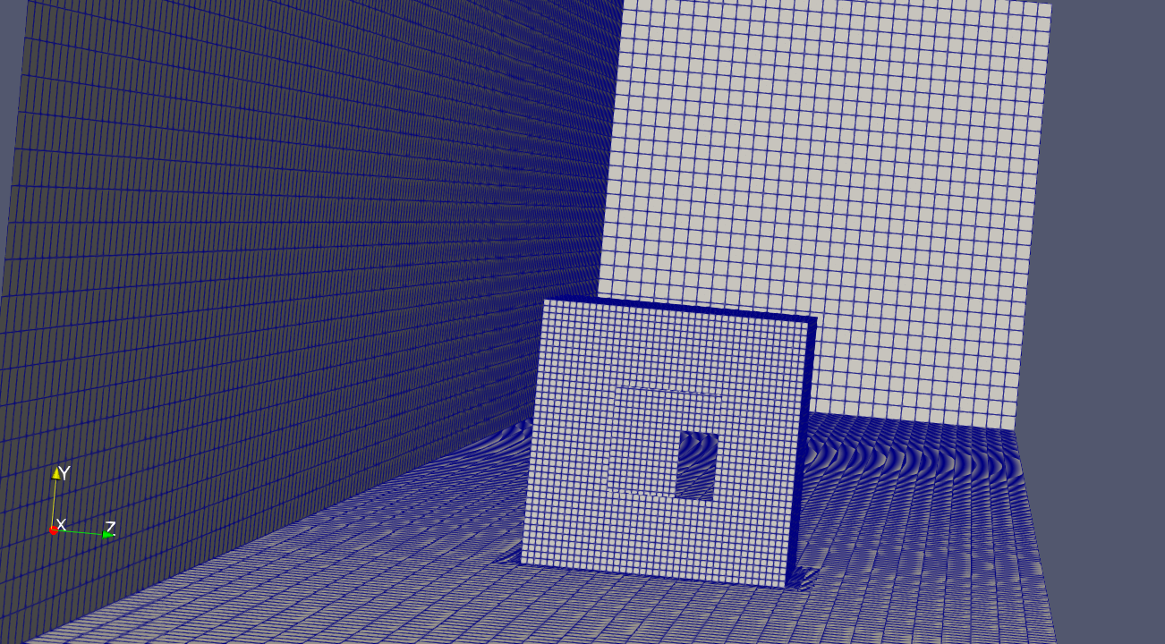
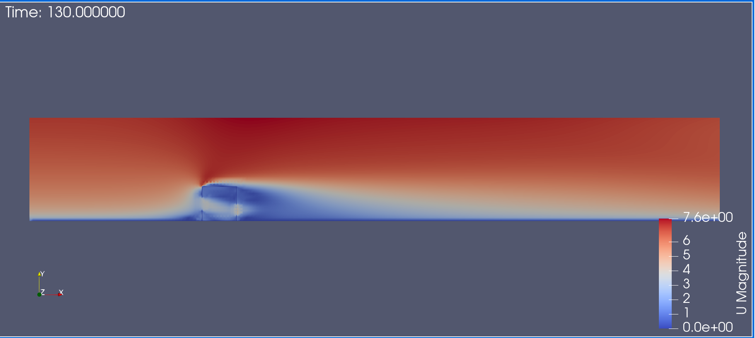
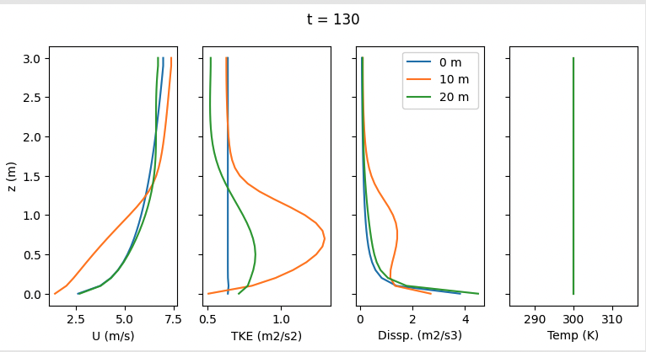
hr11D_ (shelter buoyancy slip conditions w/ windows)
* t = Iteration /10,
Residuals up to t = 70

Slide 4
Running OpenFOAM in Sherlock
Using Singularity (Docker-like) to try and run OpenFOAM in sherlock with a batch script. Get this error….

Slide 5
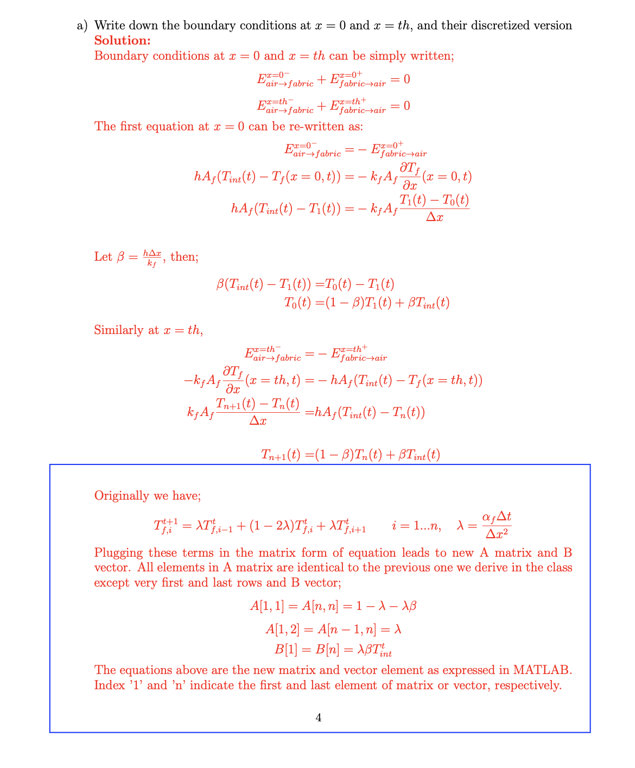
Btm - hw 6 solution

Slide 6
10/20/22

Slide 7
Building Thermal Model
Solve analytical steady state 2D heat conduction in domain to determine temperature BC on exterior building surfaces
Solve heat transfer through fabric to determine BC on interior building surfaces
Solve full analytical heat transfer solution to compare with CFD simulation

Slide 8
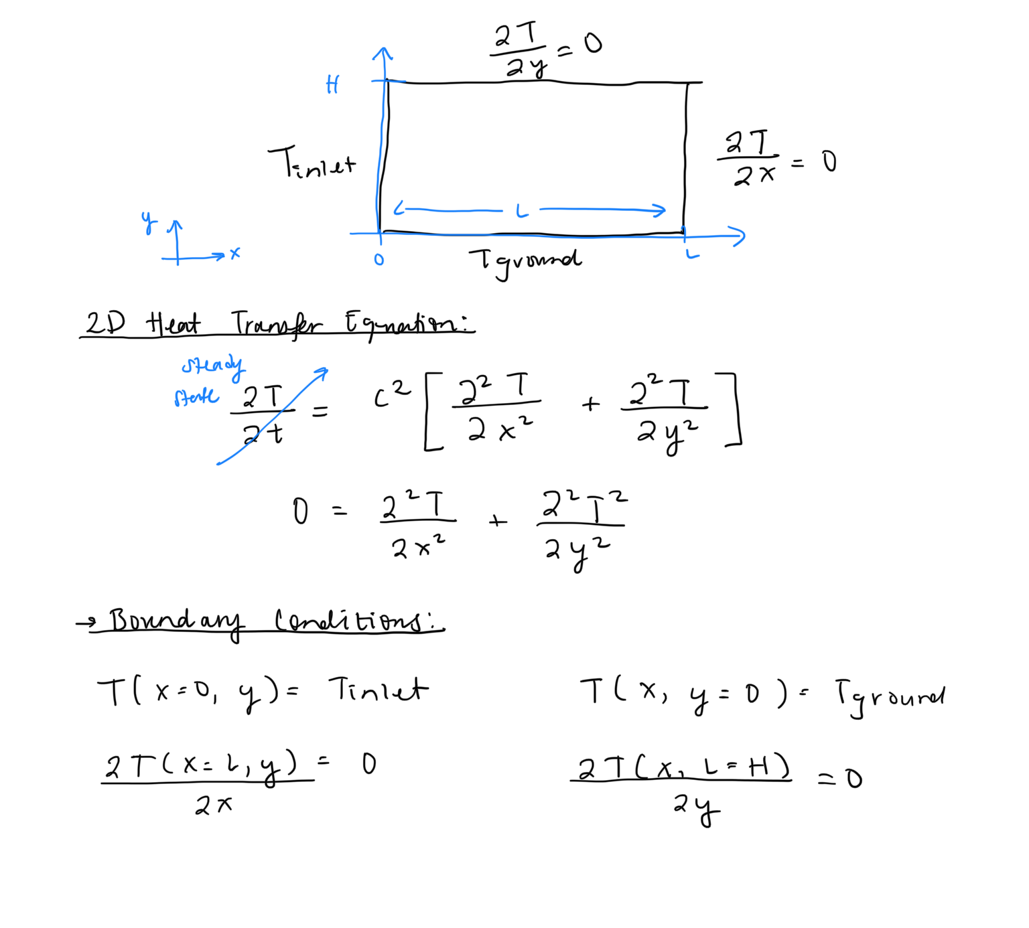
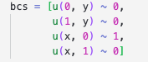
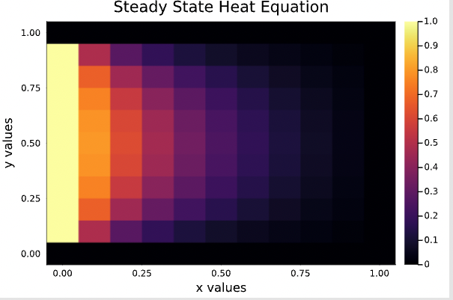
Steady State 2D Heat Conduction
Using MethodOfLines.jl, finite difference PDE solver
Getting non singular matrix error -> Incorrect boundary conditions?
Solver seems to be accurate though -> solution to Dirichlet BCs

Slide 9
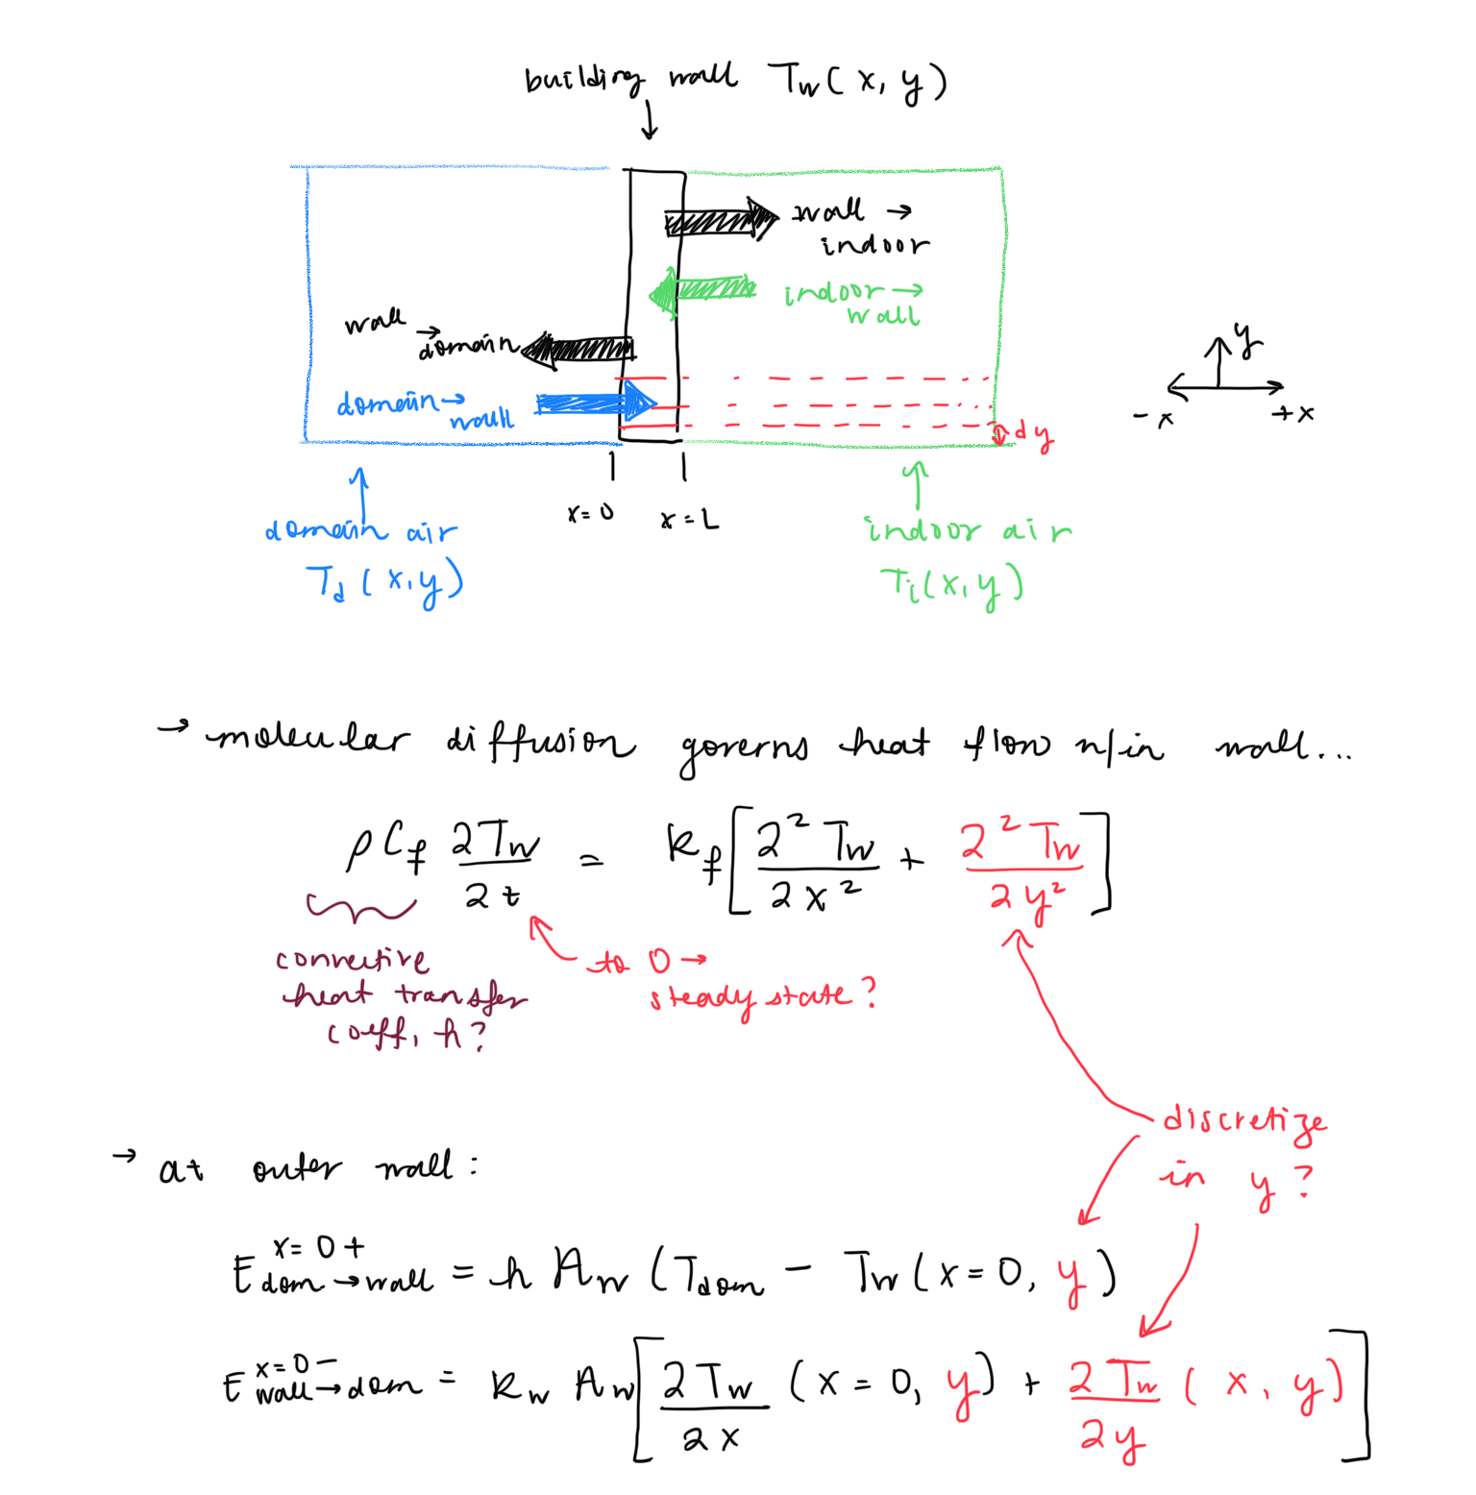
(2) Heat Transfer through Fabric

Slide 10
Back to CFD Model
hotRoom9A, hotRoom9B shelter case conditions result
hotRoom — with box from SnappyHexMesh
hotRoom — with box with window from SnappyHexMesh

Slide 11
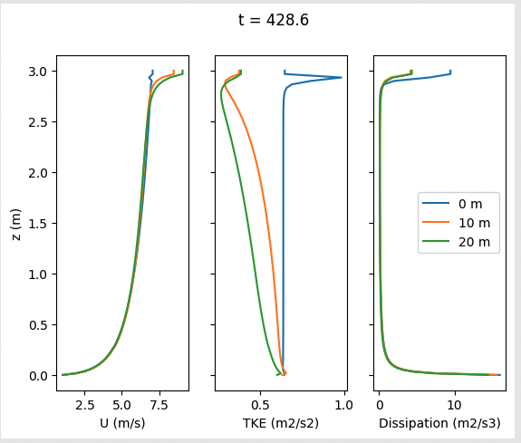
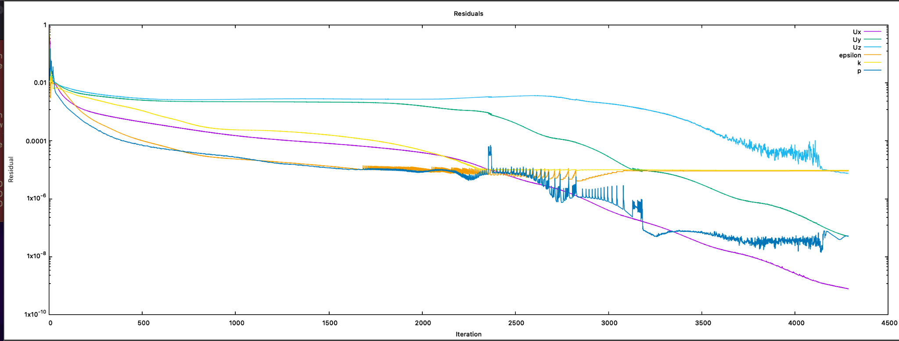
Shelter case replicas - hotRoom9A_shelterBuoy
Shelter case does not run on my laptop, so copied BCs for the domain to coarse mesh case
Converged in ~400 iterations
However, issues with the top of the domain, and decay of TKE

Slide 12
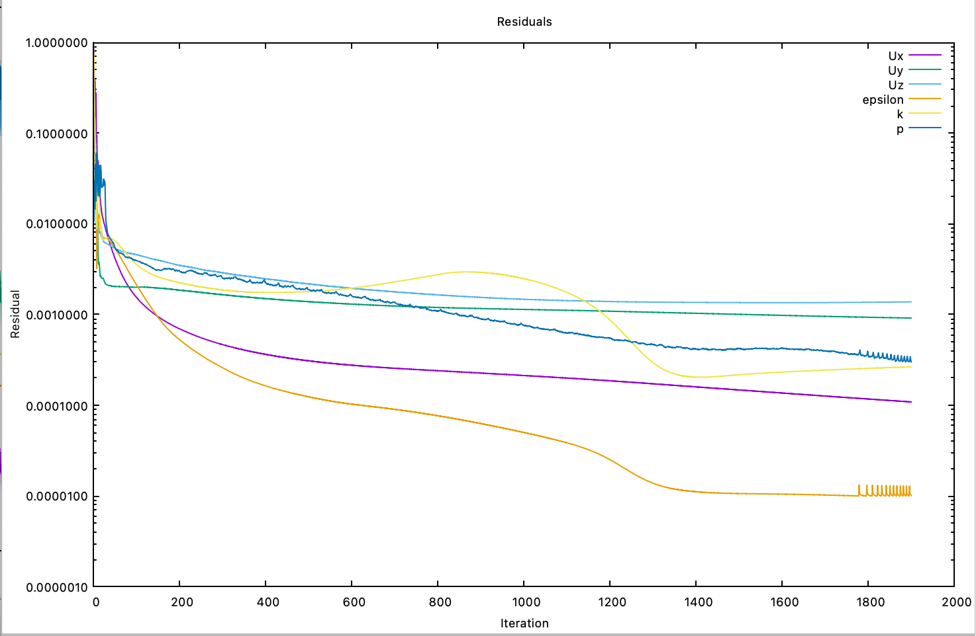
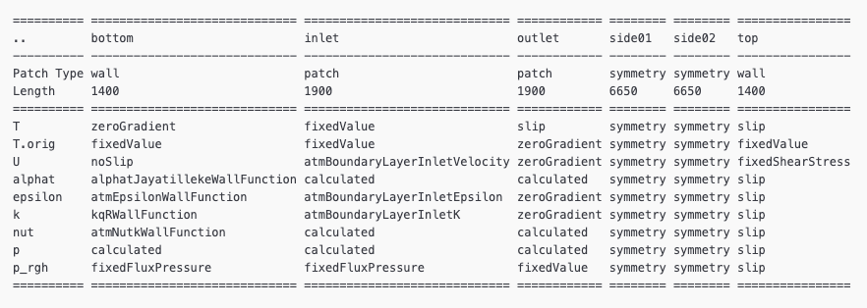
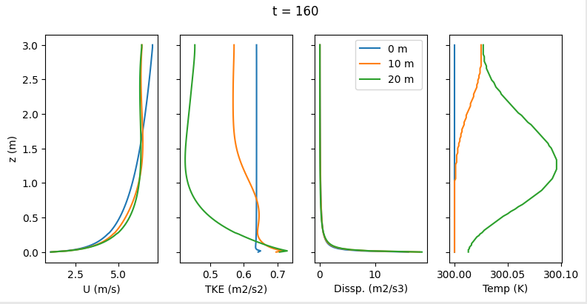
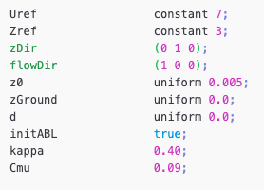
Shelter case replicas -
hotRoom9B_sbSlip
Changed boundary conditions to have slip condition on top of domain for all properties except velocity
* t = Iteration /10
corrected profiles at top of the domain

Slide 13
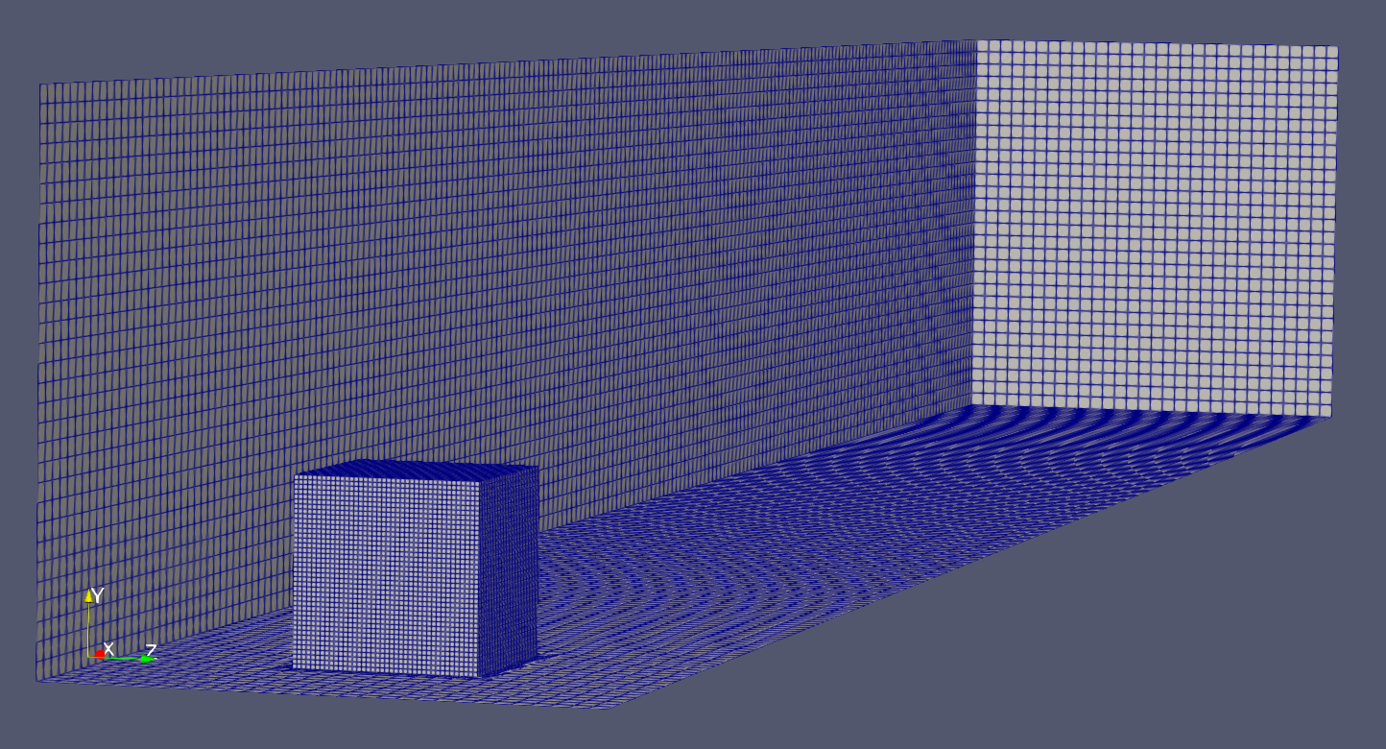
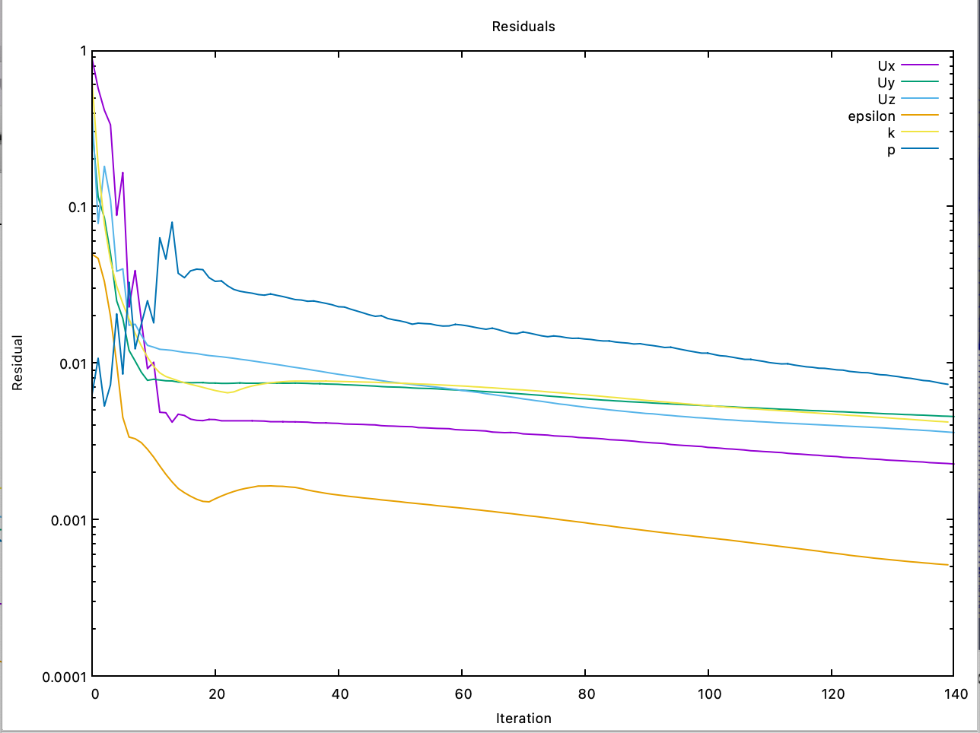
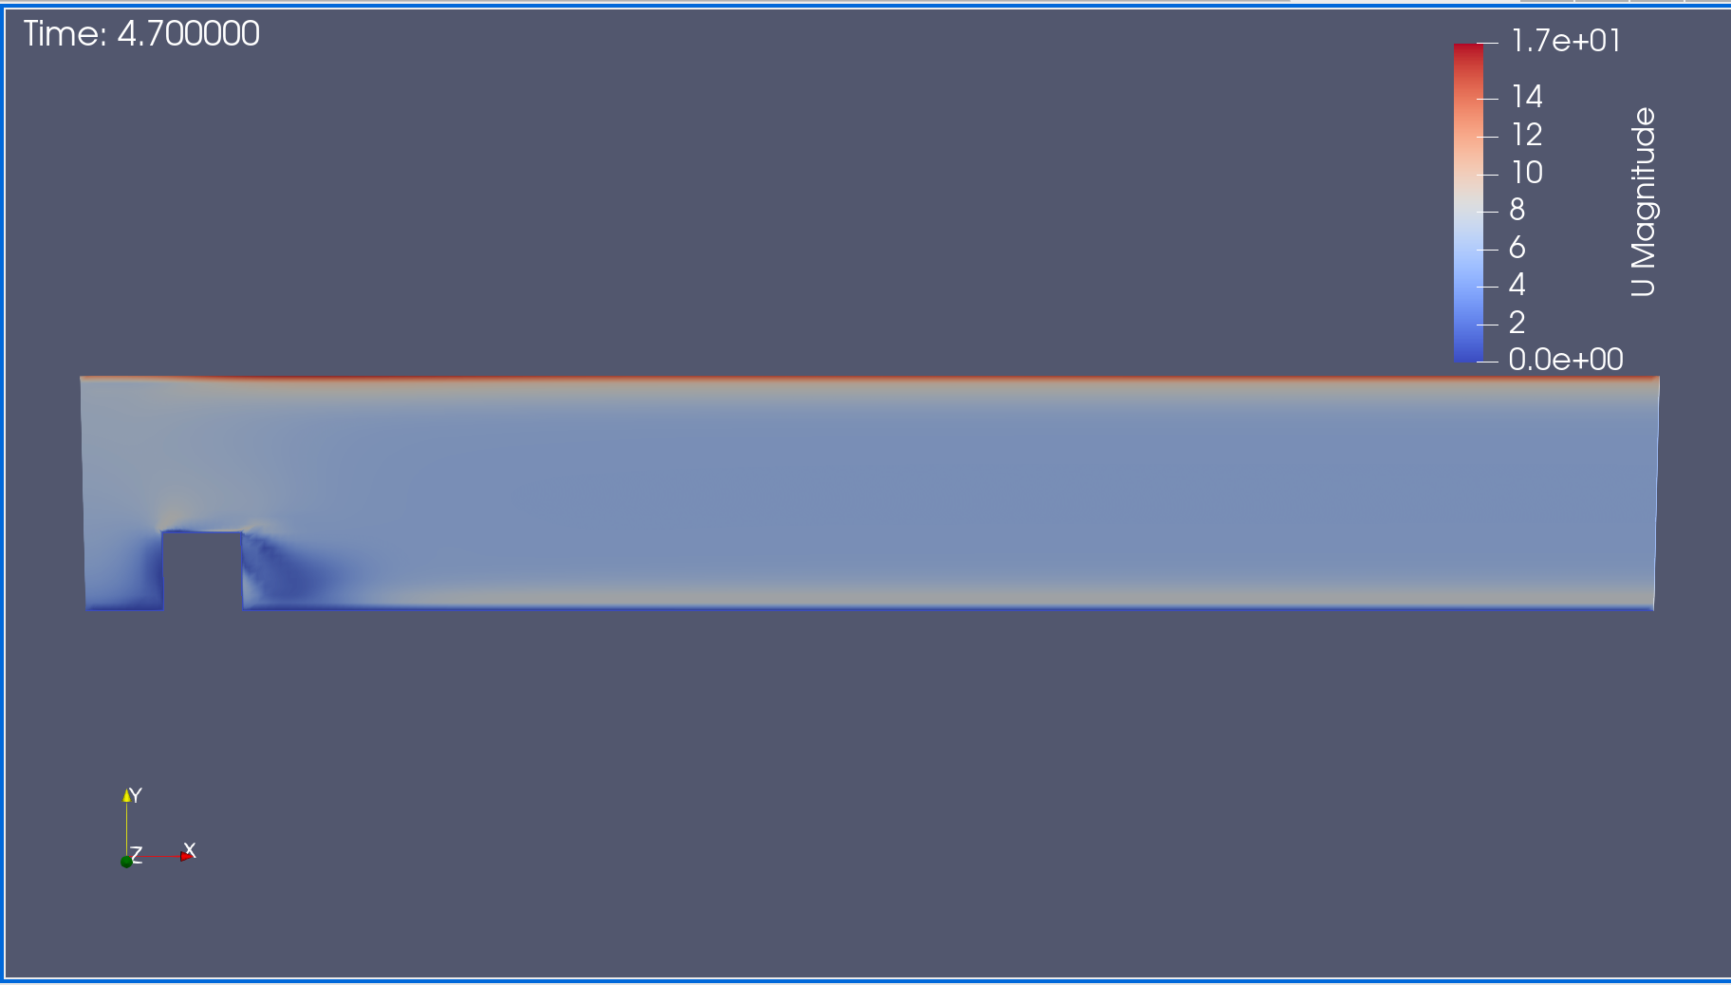
Cases with box - hotRoom10C_sbSnappy
Created box using snappyHexMesh, and applied BC from 10A (had not yet verified 10B effect)

Slide 14
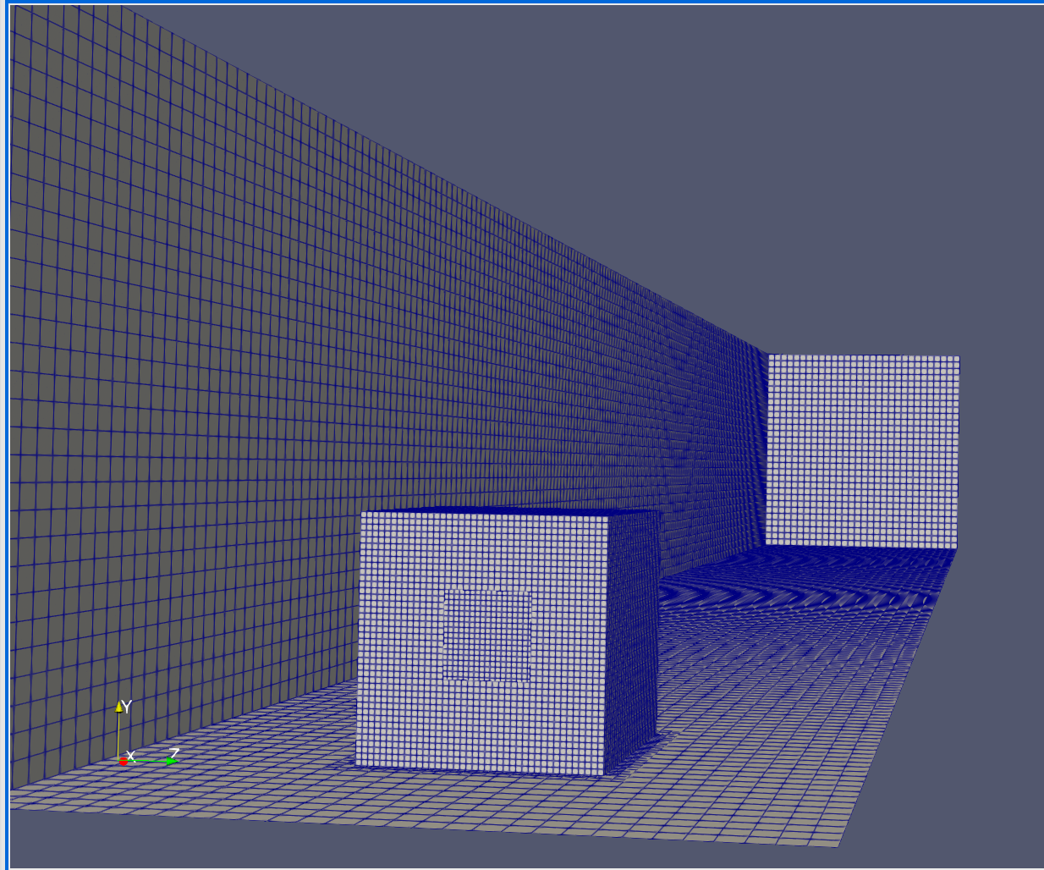
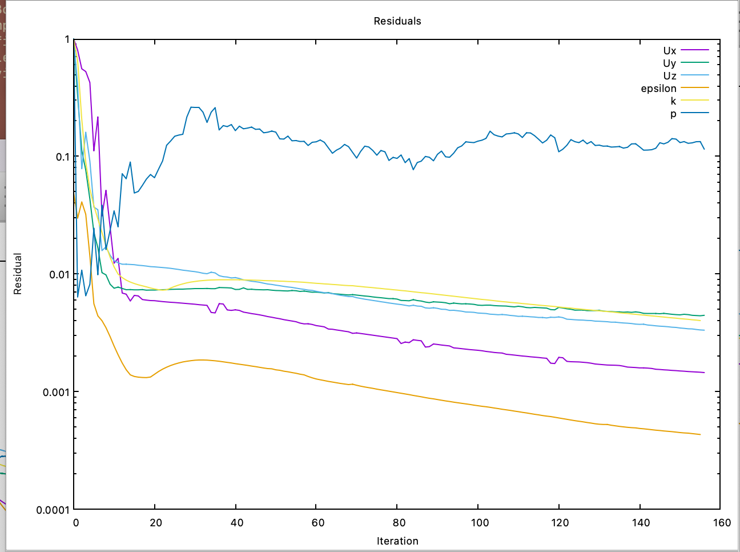
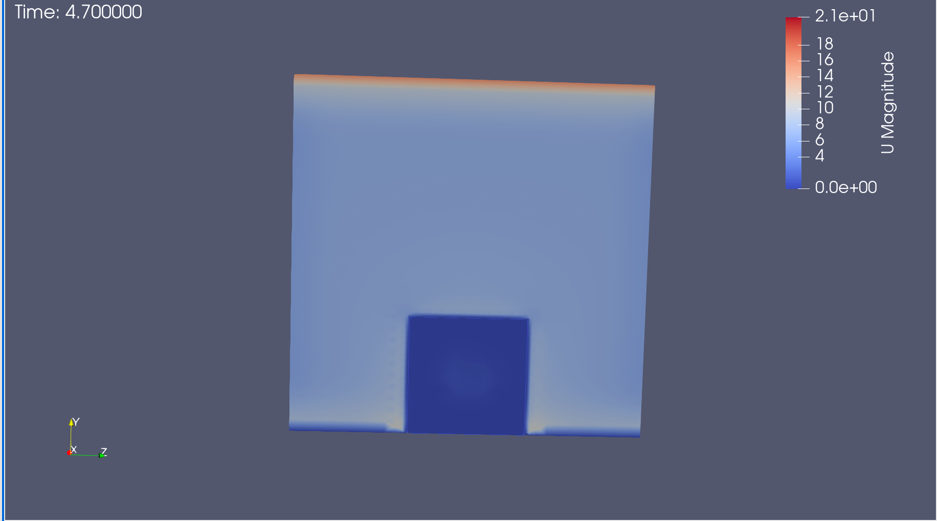

Cases with box - hotRoom10D_sbSnappyWindow
Updated box to include window, remesh with SHM
Not sure if box exterior/ interior walls being considered…
Concerning pressure residual…
Notes:
Another window -> front and back ..

Slide 15
Next Steps
Try to replicate this model in E+, look into how that works
Run 10C and 10D in w/ BC from 9B
Sherlock
Fix btm, and see if can apply BC to models

Slide 16
9/22/22

Slide 17
Buoyancy Cases - hotRoom9A
Shelter case does not run on my laptop, so copied BCs for the domain to coarse mesh case
Converged in ~400 iterations
However, issues with the top of the domain, and decay of TKE

Slide 18
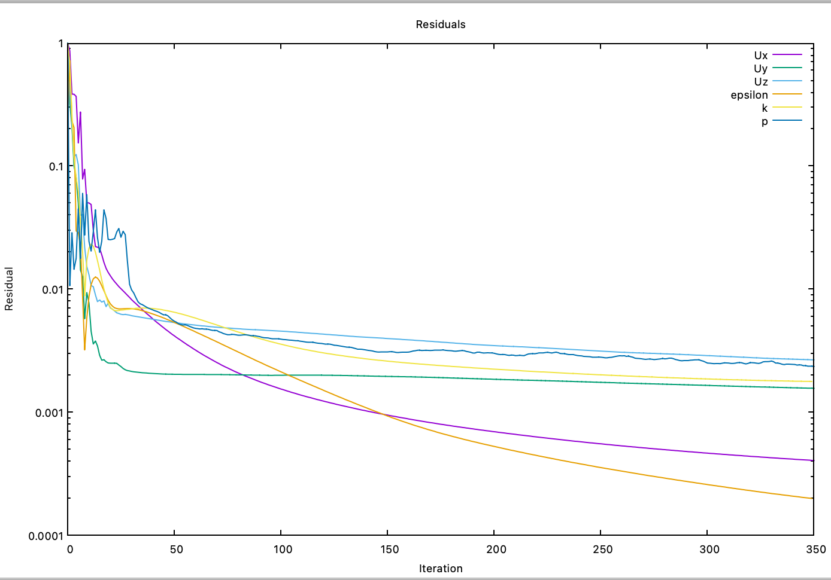
Buoyancy Cases - hotRoom9B
Changed boundary conditions to have slip condition on top of domain for all properties except velocity
Waiting to look at results

Slide 19
Next Steps
Added in a box, in process of running this case
Access a cluster -> Sherlock?
Add a window on the box inside domain that can serve as a window
Run a transient simulation and somehow vary the temperature with time to match temperatures from weather station
How long to run this for?
Assign material properties to the box?
Conjugate heat transfer problem?
Simple building thermal model?
Best dimensions for coarse mesh and capture meaningful temperature variation?
Run Energy+ simulation
Create very simple cube geometry, same dimensions as CFD case…
Create custom weather file
Run simulation for same length of time as CFD model..
Iterate to calibrate material properties
Notes:
Run e+, matlab build therm model, work on building up openfoam…
Use results of of to adjust e+, see how this changes
Lup wai etc papers… closing loop

Slide 20
9/15/22

Slide 21
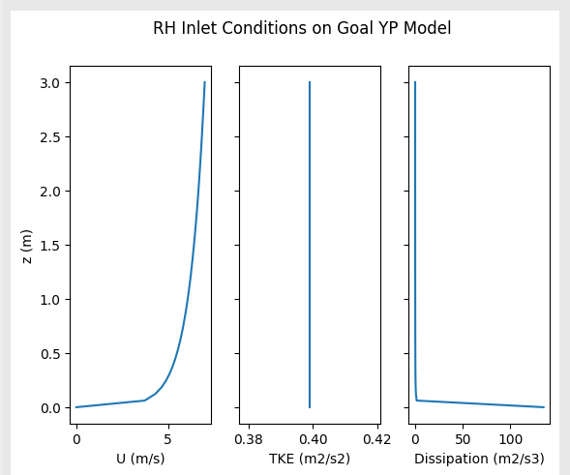
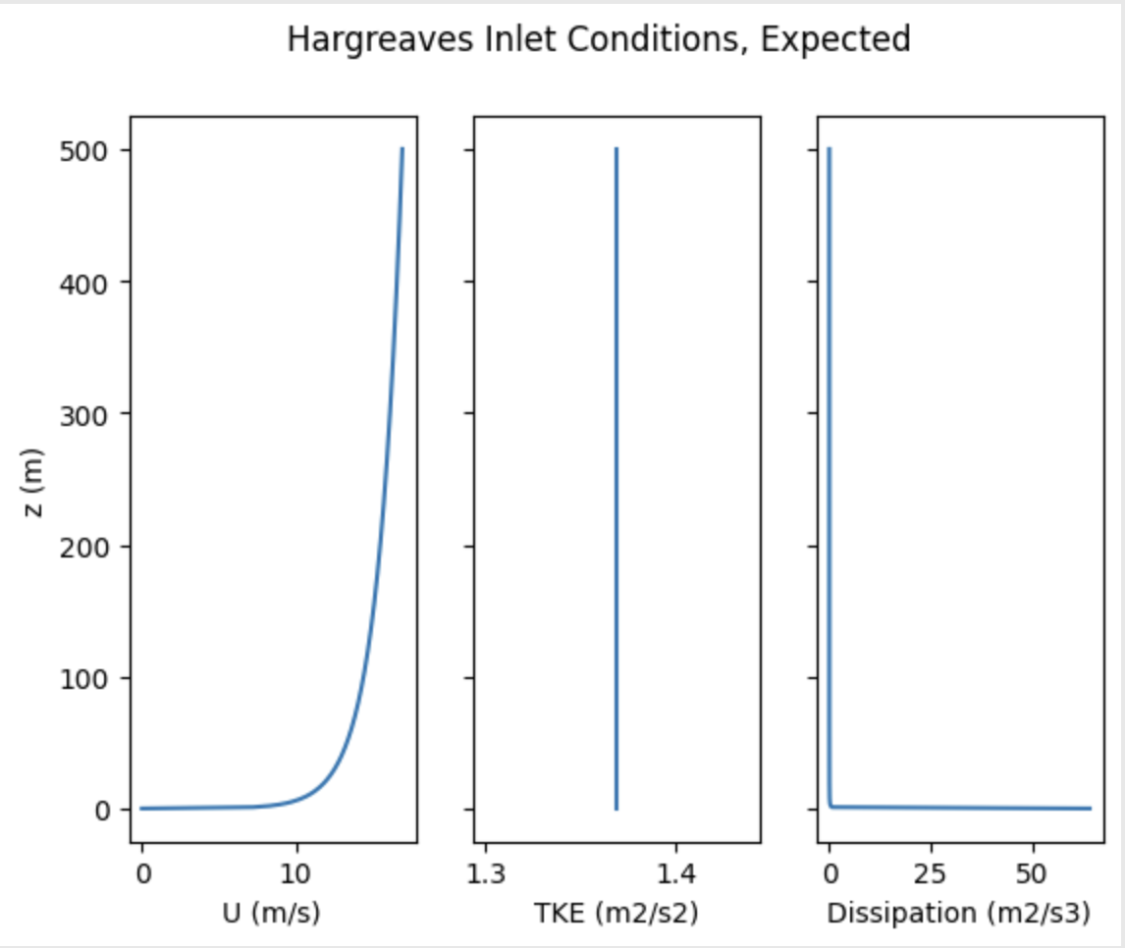
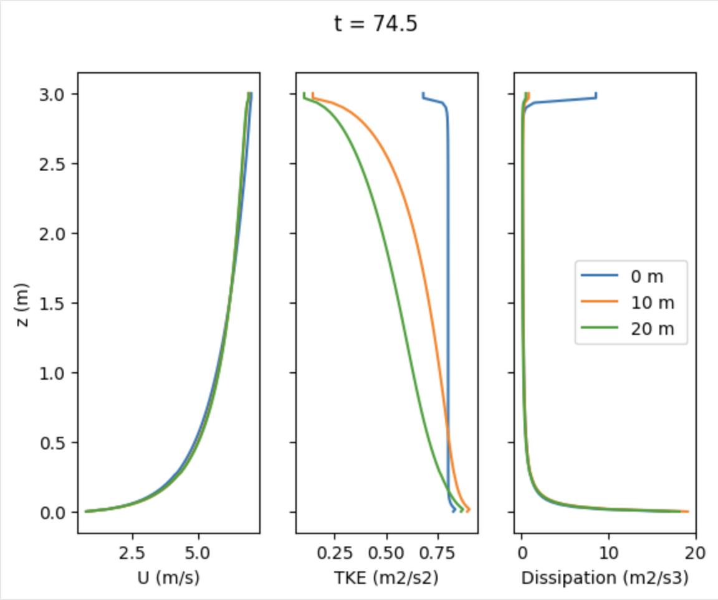
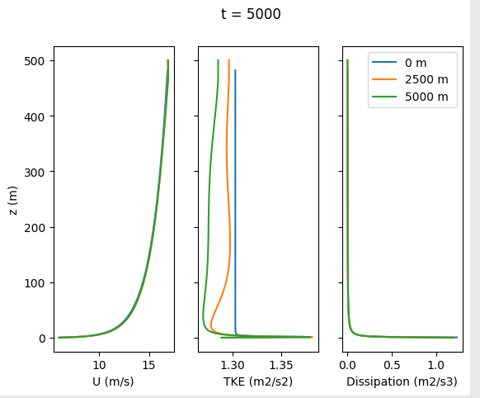
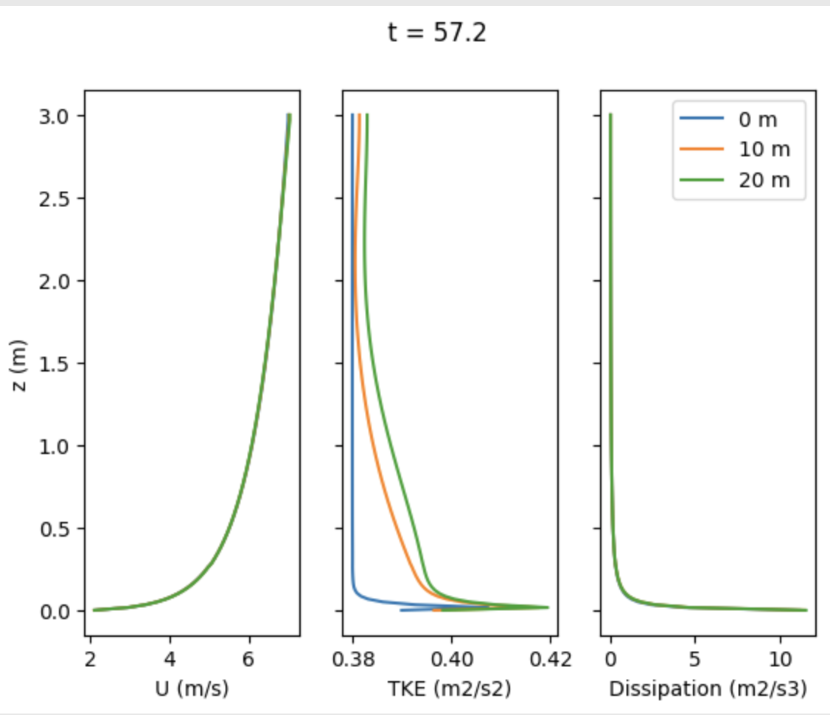
ABL Profiles for SimpleFoam Cases
6K - fixed velocity at top
6L - shear stress at top
Hargreaves - shear stress at top
U_ref = 7 m/s, z_ref = 3 m, z_o = 0.01 m
Same as 6L
U_ref = 10 m/s, z_ref = 6 m, z_o = 0.01 m
calculated
observed

Slide 22
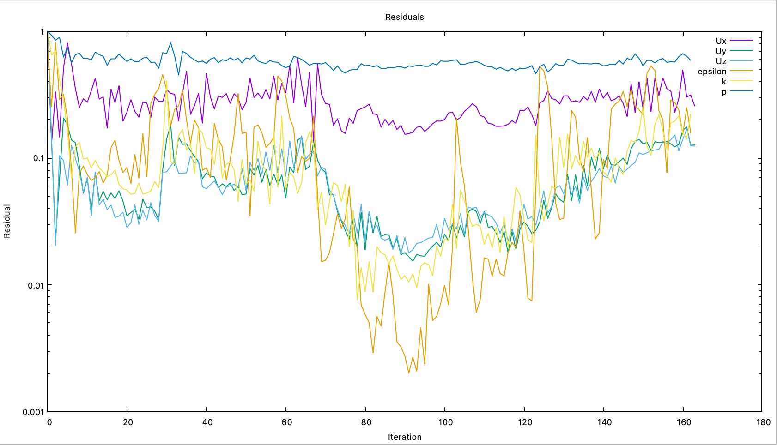
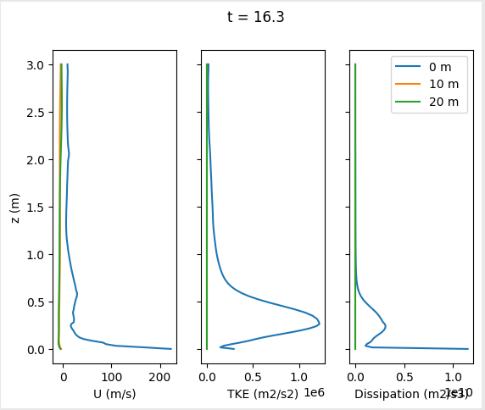
Consider Buoyancy - hotRoom8L
buoyantBoussinesqSimpleFoam

Slide 23
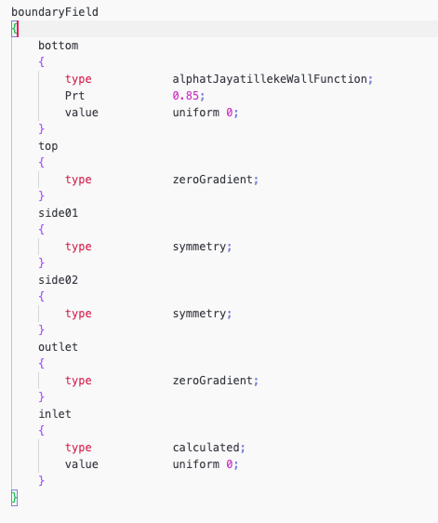
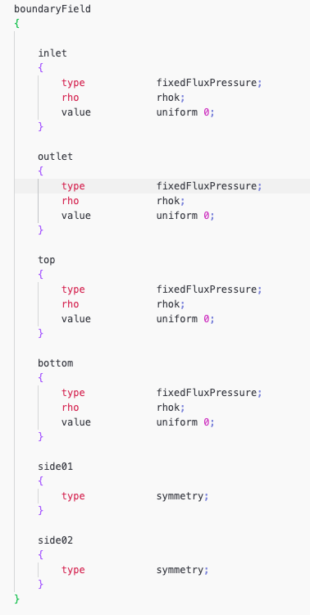
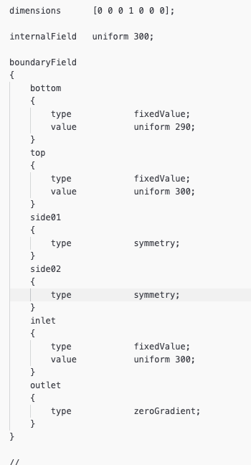
Alphat, T, p_rgh

Slide 24
Window Data

Slide 25
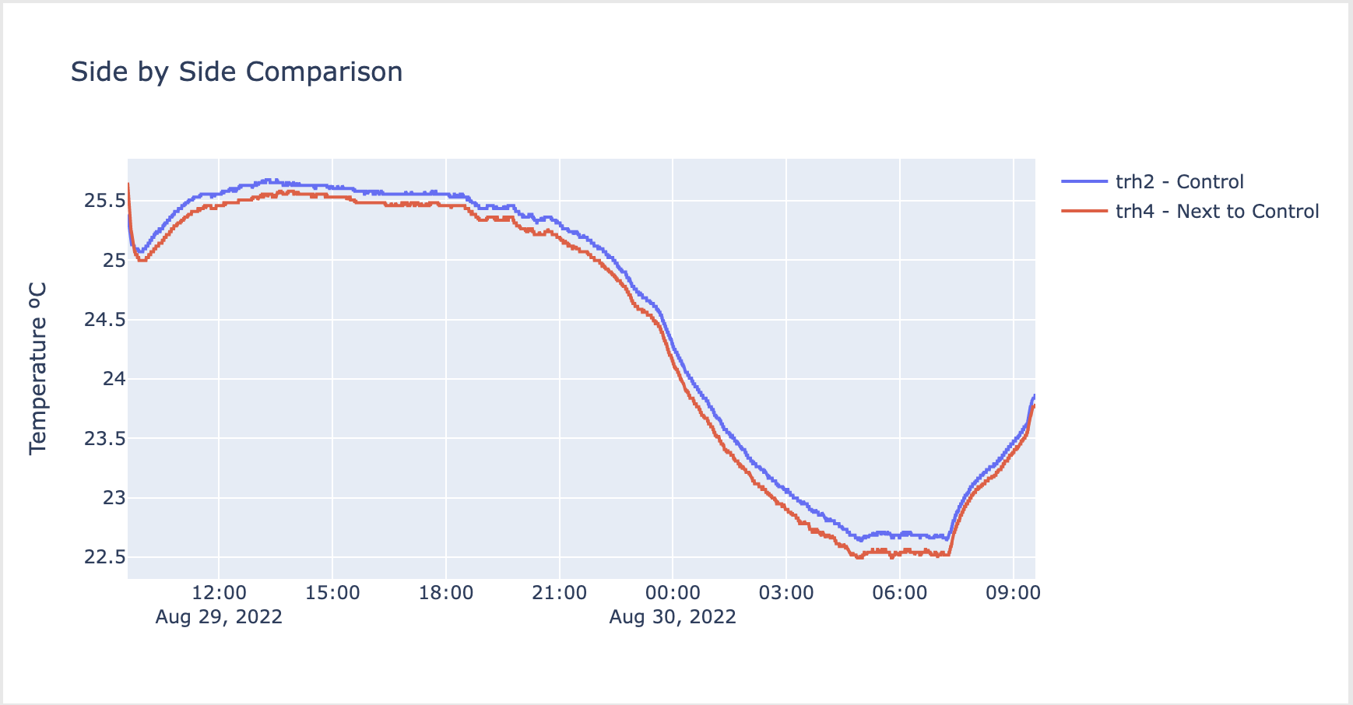
RMSE = 12.02% (0.1202)

Slide 26
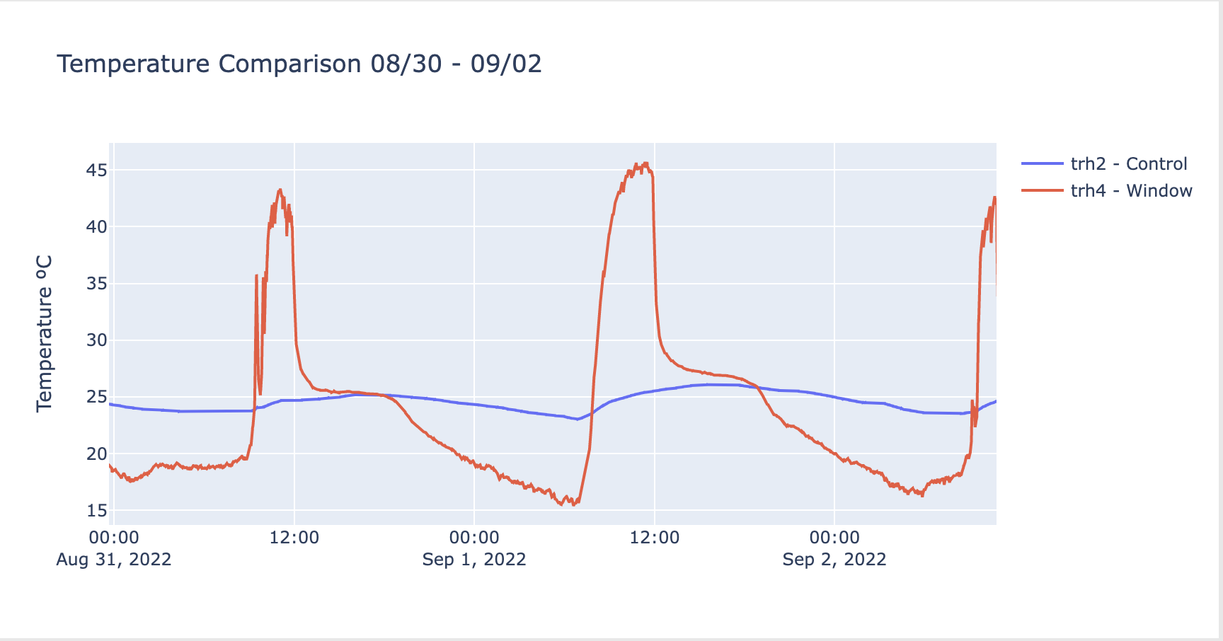
RMSE = 724%

Slide 27
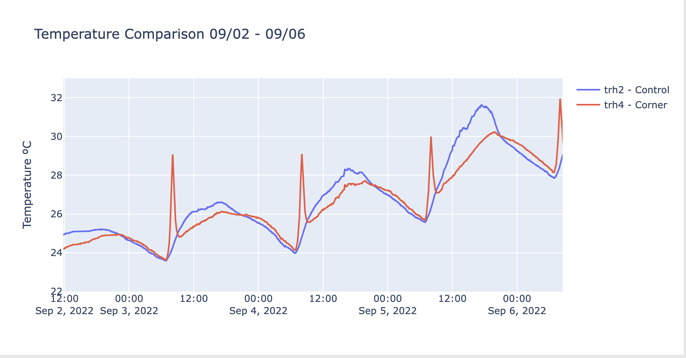
RMSE = 86.1%

Slide 28
9/8/22

Slide 29
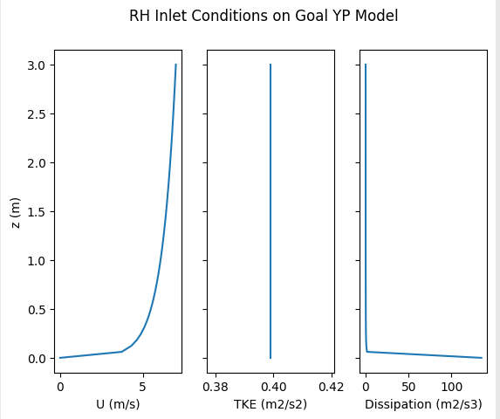
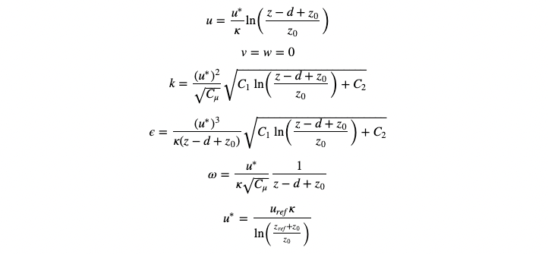
Desired Profiles
U_ref = 7 m/s at z = 3m => u_star = 0.346
3 x 3 x 20 m empty wind tunnel
simpleFoam
Profiles should be the same at inlet and outlet in empty WT
Openfoam atmBoundaryLayer Equations, collapse to expected when C1 = 0, C2 = 1

Slide 30
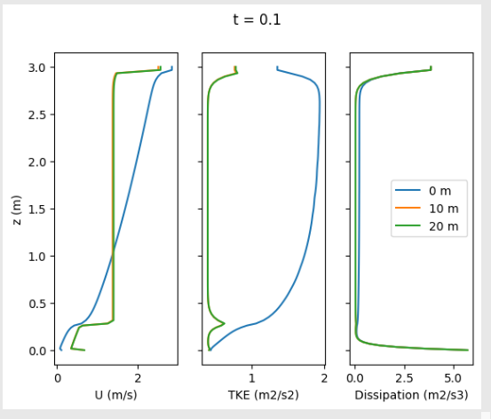
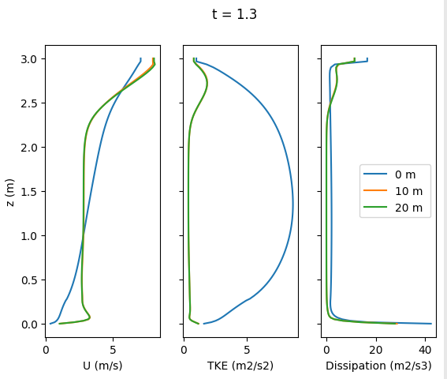
hotRoom_6K
TKE and velocity profiles look very strange, and change from inlet to outlet

Slide 31
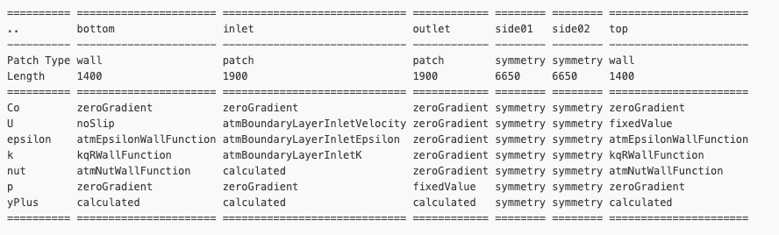
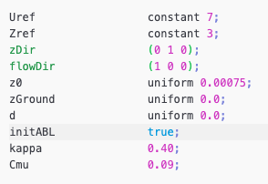
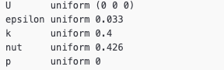
hotRoom6K - Boundary and Inlet Conditions
Internal Fields
ABL Conditions

Slide 32
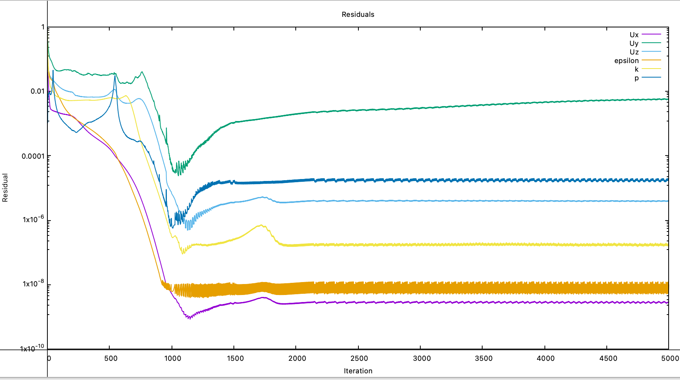
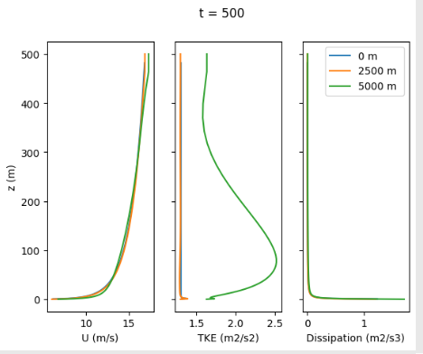
2007 Hargreaves
OpenFoam example using atmBoundary conditions
Upper boundary is not a wall, and has a shear stress for velocity
500 x 100 X 5000 m model

Slide 33



2007 Hargreaves - Boundary and Inlet Conditions
Internal Fields
ABL Conditions

Slide 34




hotRoom6L => a mix
Attributes from Hargreaves are copied, particularly on the upper boundary
Same boundary condition values from 0.346 friction velocity (hotRoom6K) and 3 x 3 x 20 m model
Not sure if applied shear is correct because not sure how to figure out density OF is using
Possible culprit? Large cell volume gradient?

Slide 35


hotRoom6L - Boundary and Inlet Conditions
Internal Fields
ABL Conditions

Slide 36
9/1/22

Slide 37



hotRoom6H_yPlus

Slide 38


Slide 39


Slide 40


Slide 41


Slide 42
8/25/22

Slide 43
ABL Wind Tunnel

Slide 44

hotRoom4C_topVel
Set up
Unstructured mesh wind tunnel with box
buoyantBoussinesqSimpleFoam solver
ABL conditions
Results
Solution blows up by t=8
Notes:
Look at residuals, courant number, force… -> graphs
Geometry screenshots in steps before blow up
Have picture of mesh with bcs labeled
Have discretization schemes included

Slide 45

Notes:
Look at residuals, courant number, force… -> graphs
Geometry screenshots in steps before blow up
Have picture of mesh with bcs labeled
Have discretization schemes included
Wrong flow dir
Chek nut, on outlet should be zerograf
Check that k and epsilon satisfy relationships with c (mu)
Plot values at wall overtime
Internal field for yu
Cross check what abl should look like
Temperature abl look up
Castro cities simulation

Slide 46




Velocity Magnitude
t = 0
t = 1
t = 2
Notes:
Look at residuals, courant number, force… -> graphs
Geometry screenshots in steps before blow up
Have picture of mesh with bcs labeled
Have discretization schemes included
Boussinesq how flow changes with nicer mesh

Slide 47

Ux

Slide 48

Turbulent Kinetic Energy

Slide 49

hotRoom6C_ABL
Set up
structured mesh wind tunnel without cube
simpleFoam solver
ABL velocity conditions
Results
Runs, but residuals don’t look correct

Slide 50

Notes:
Directions here are also messed up!

Slide 51




Slide 52

Ux

Slide 53

TKE

Slide 54


hotRoom6G_ABL_WTBMesh
Set up
structured mesh with wind tunnel box
simpleFoam solver
tried with ABL velocity conditions, as well as ABL wall functions
Results
Solution blows up by t = 8

Slide 55


Slide 56



t = 0
t = 4
t = 7
Notes:
The directions here are messed up!

Slide 57
Temperature Measurements

Slide 58

Open vs Sometimes Open
Grey shading indicates when window is closed in 422B
Notes:
T drops -> likely window open, delta => difference in them, try to classify different, diverge for rooms close to each other w/ diff window treatments
Open windows at night, how does the temperature change vs days when dont ….
Can see that when windows are close in 422B, there is a difference in temperature -> compare how the magnitude of the delta for day vs night
When the window is open again, the temps in both rooms converge -> compare how long it takes to converge for night vs day
Could classify and name each window open close event, and rank based on the above measurements
See if can predict whether the window is open / closed based on the temperature delta
Do similar experiment for rh, and then both combined. See which are the best predictors
Build an e+ model, put in outdoor temperatures. Guess materials / can calibrate using relationship between temp and open windows…
Could build a model that says given outdoor t (and/or rh) this will be the indoor temperature. 422B might be a better measure since it was always empty
Note relative effect of heat sources (lights, people, computers) -> looking at data in 422a, are there deviations from a mean curve at certain times of day?
Look at coefficients and heat transfer models being used.. (link to cfd: does the cfd predict these coefficients too? Also, looking at air and temp flows from this model could help in predicting how changes to room geo / build up would affect cooling potential)

Slide 59

Closed vs Sometimes Closed
Grey shading indicates when window is closed in 422A
Notes:
Sensors next to each other, near window far from it, energy models
Avoid doing conjugate heat transfer problem, cfd to improve the epistemic uncertainty
Wrong flow rates

Slide 60

Open vs Closed
Notes:
Next steps on this?
Early Predictive model? Would need more evenly distributed data (can collect more data until 9/10)… would want to know how affects energy use… like use of fans since no AC in rosse? Also have RH data
Bringing temp + cfd model together… understand how temp outside affects temp in room, as well as airflow… a good e+ model would allow to see what geometrical params to adjust and improve performance of the open window room
But what is even ideal?

